Slide 1
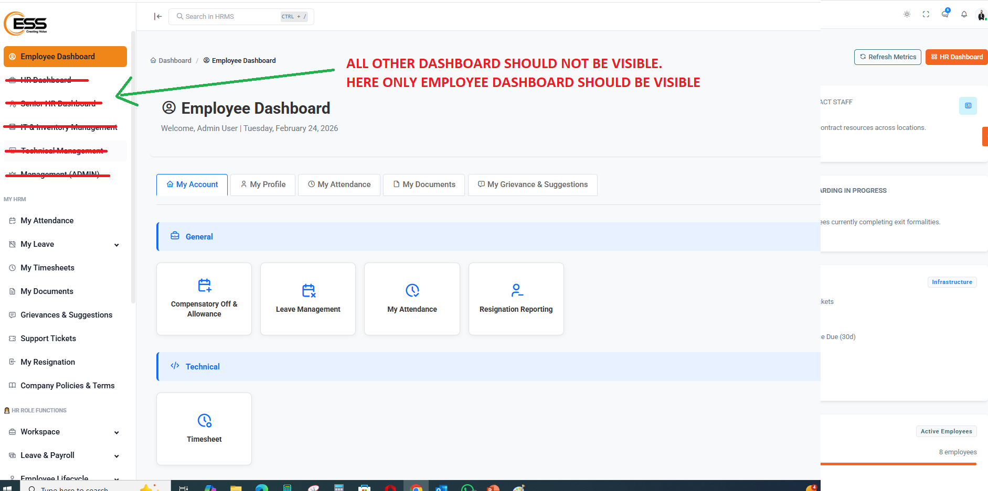
1) Fix Dashboard area

Slide 2
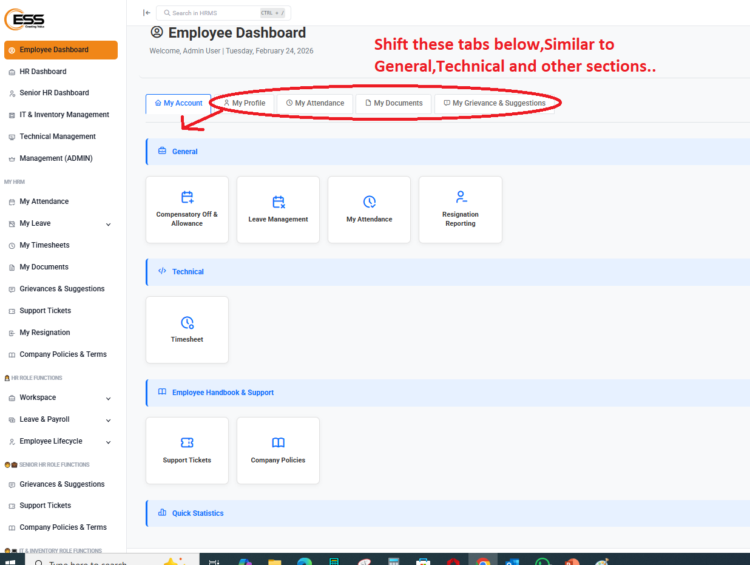
2) Shift these tabs below,Similar to General,Technical and other sections..

Slide 3
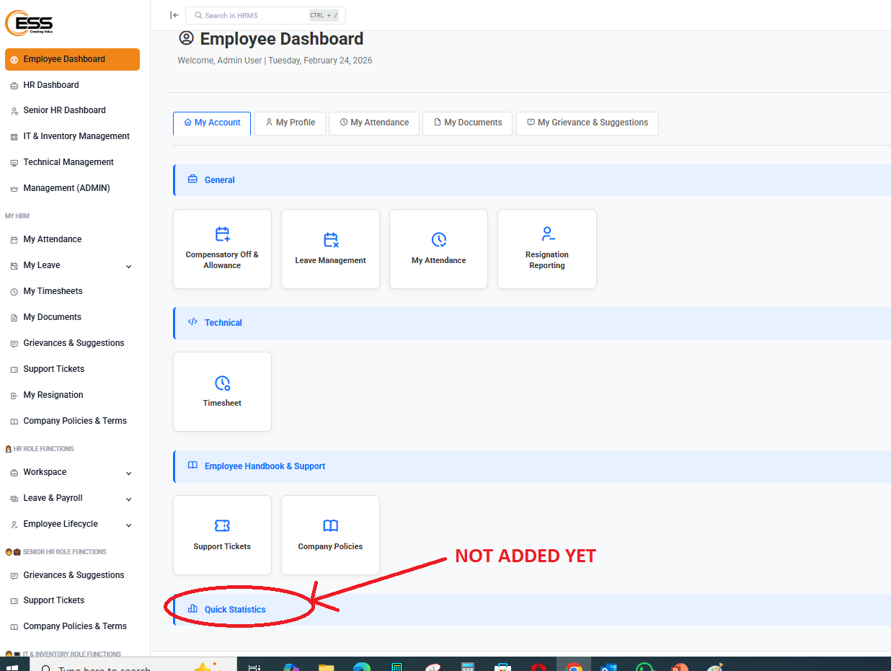
3) Statistics NOT added yet

Slide 4
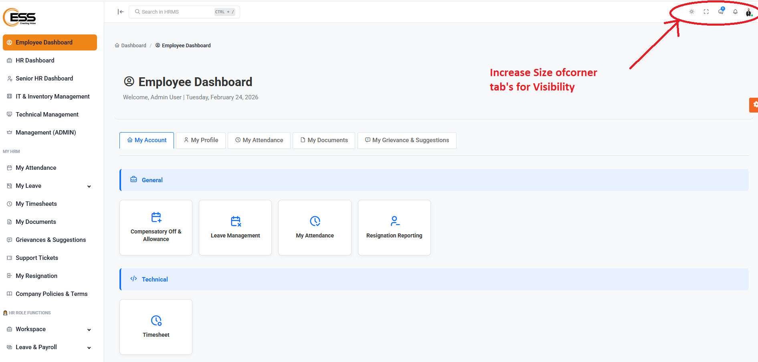
4) Increase Size of corner tab's for Visibility

Slide 5
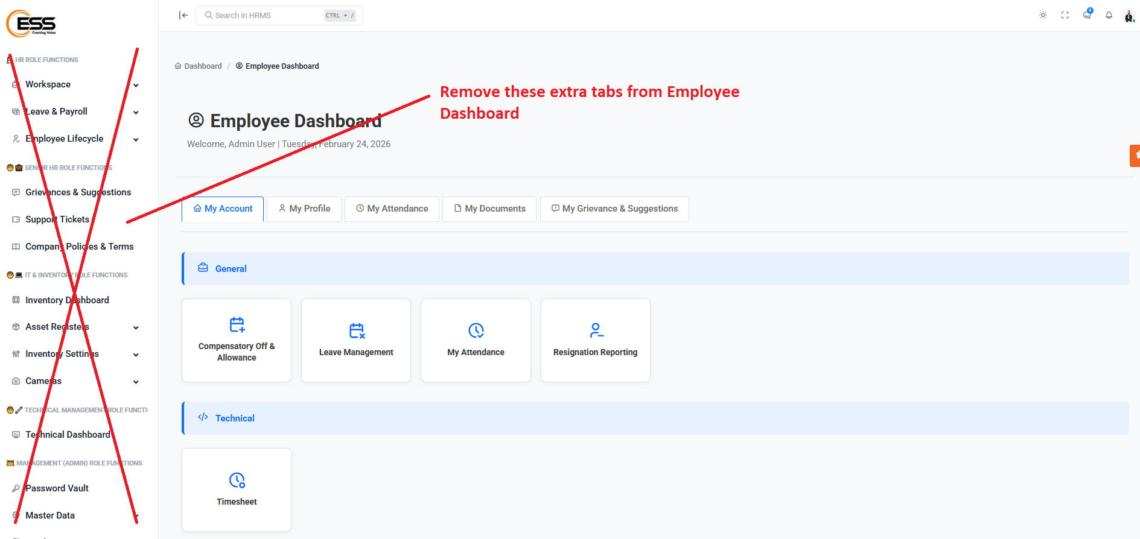
5) Remove these extra tab from Employee Dashboard

Slide 6
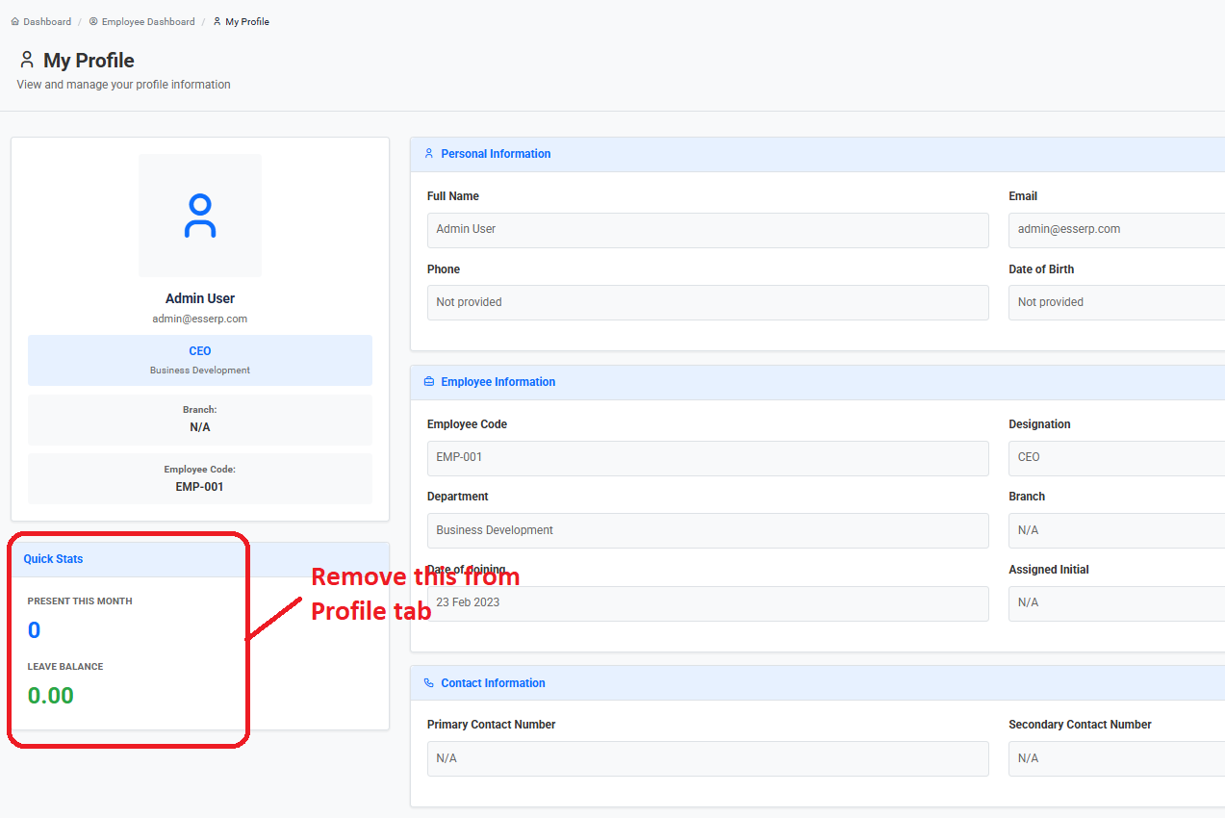
6) Remove this from Profile tab

Slide 7
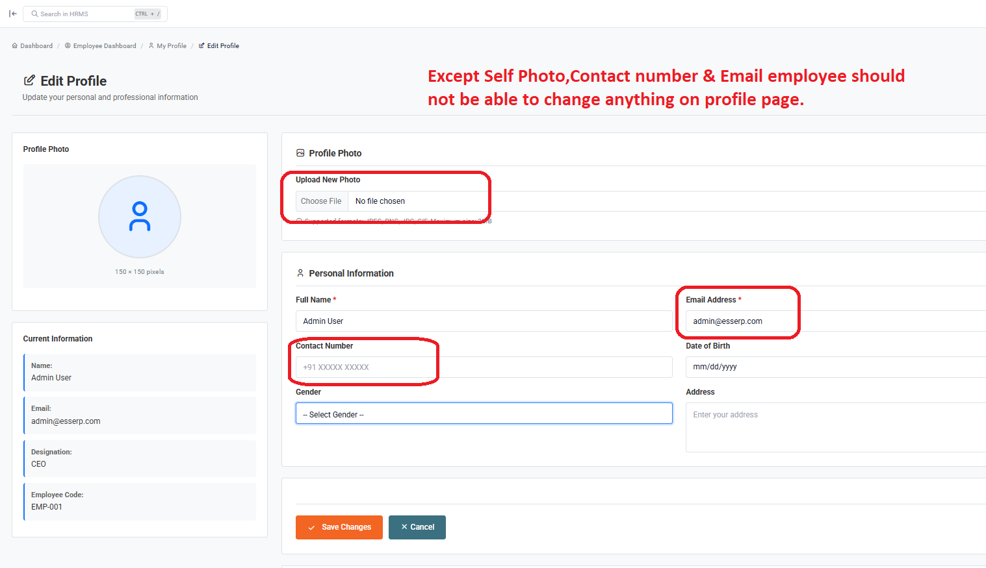
7) Except Self Photo, Contact number & Email employee should not be able
to change anything on profile page.

Slide 8
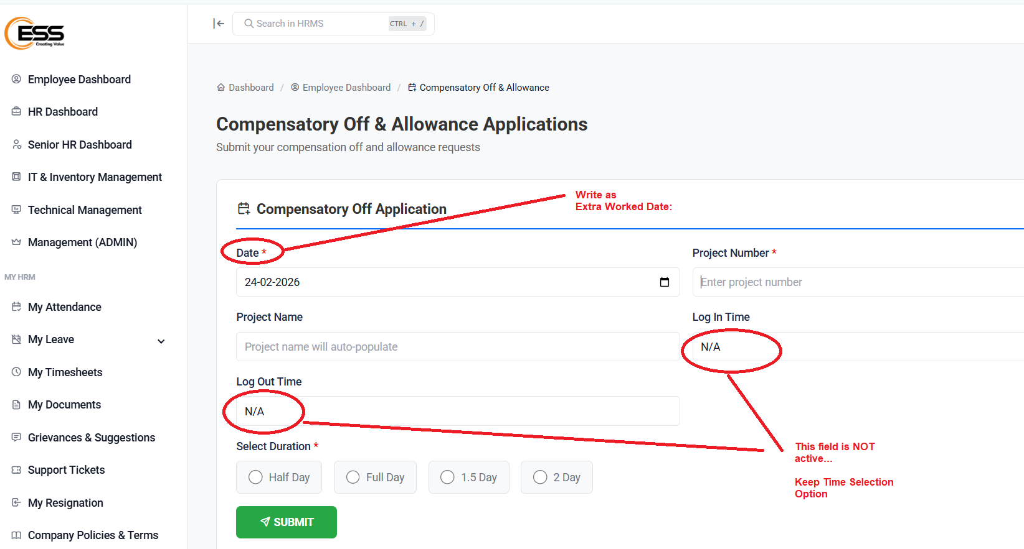
8) Fix Comments

Slide 9
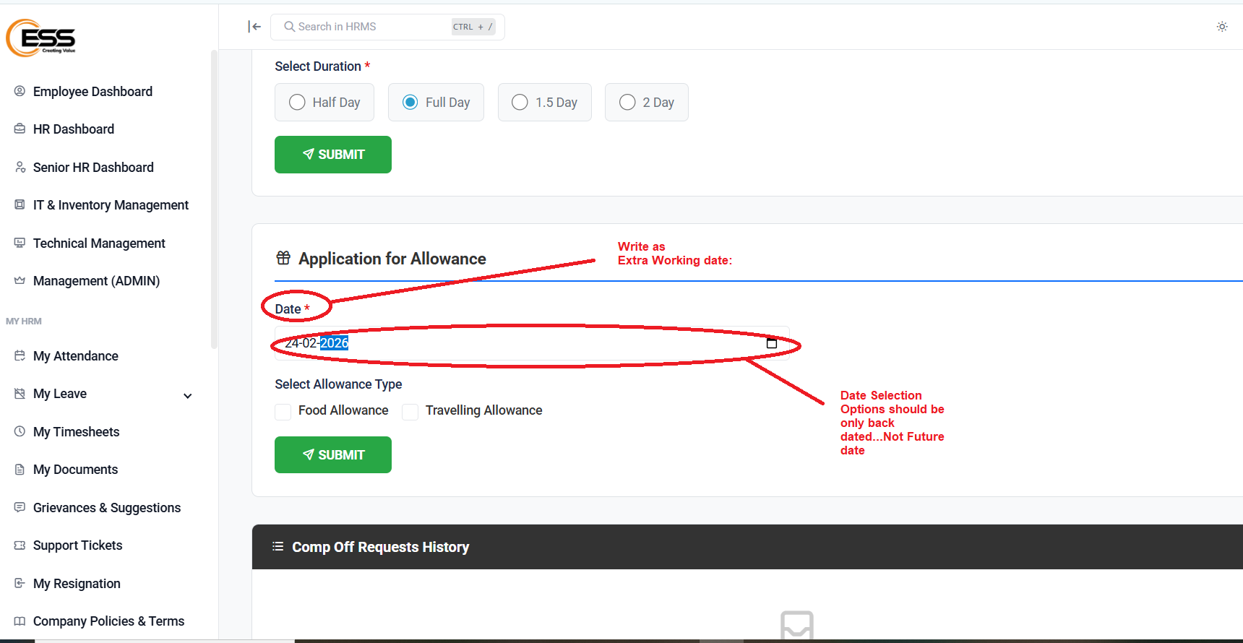
9) Fix Comments

Slide 10
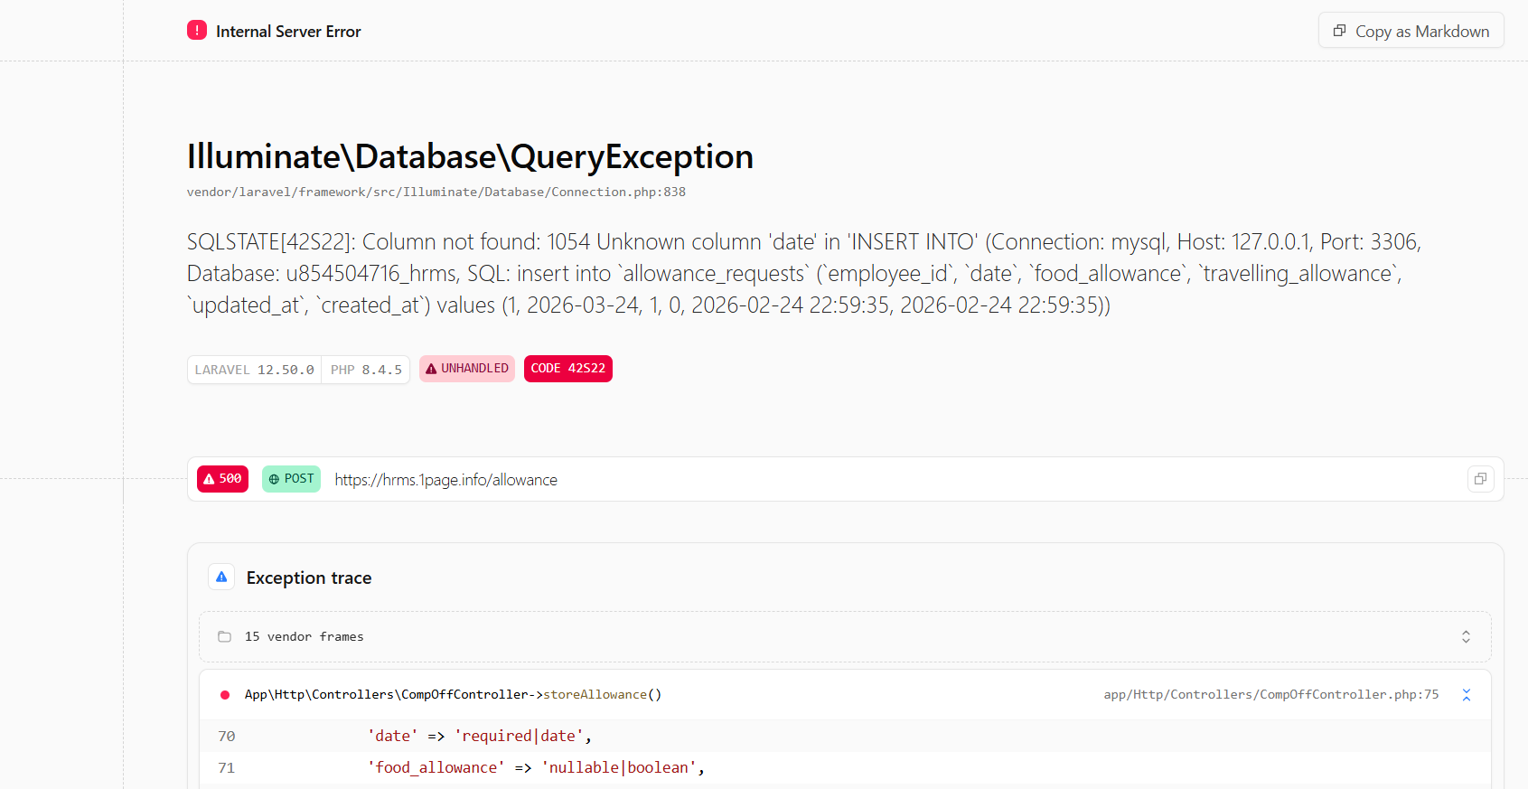
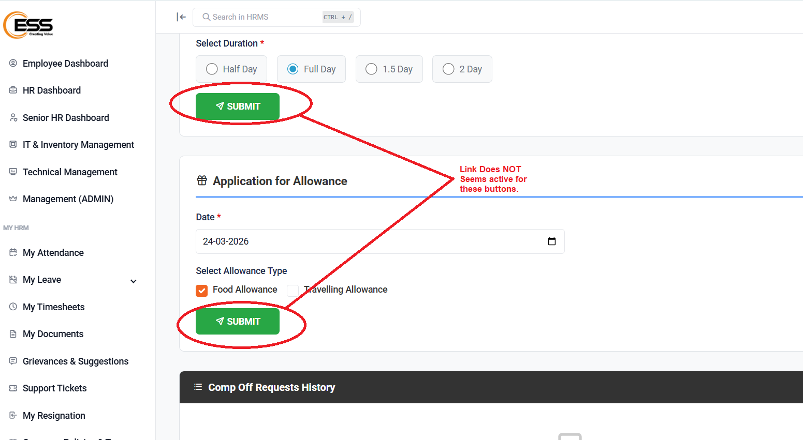
10) Fix Comments .It shows error

Slide 11
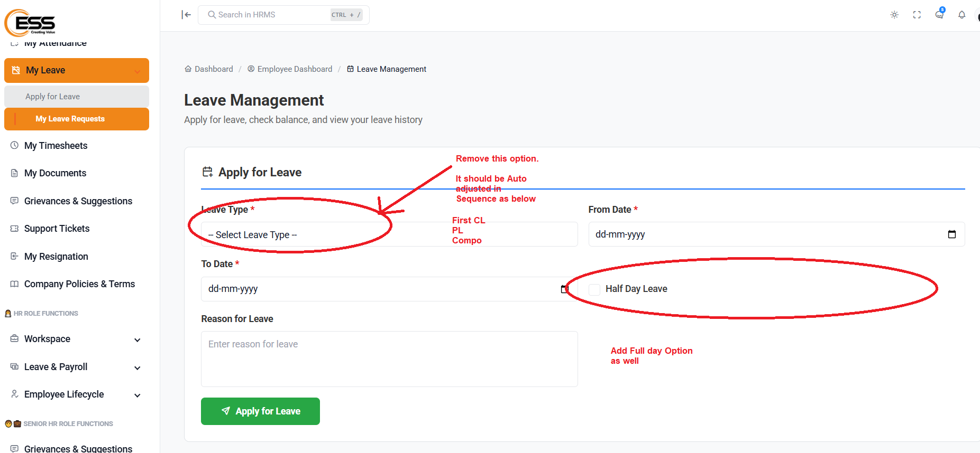
11) Fix Comments .

Slide 12
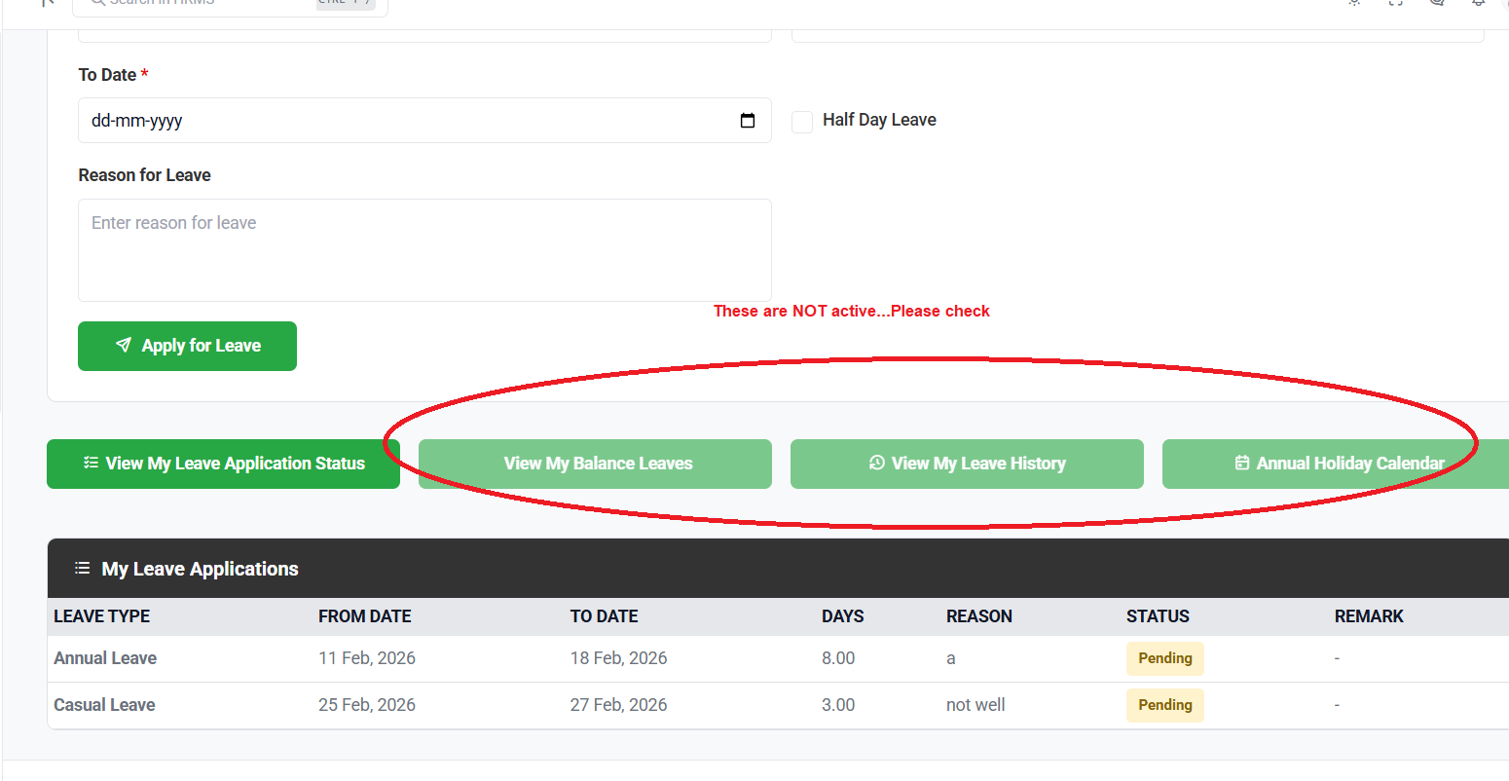
12) Fix Comments .

Slide 13
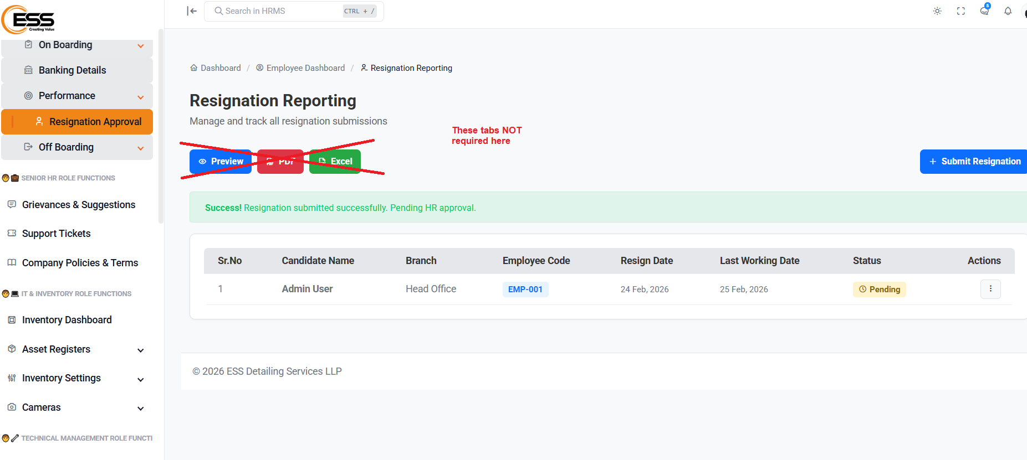
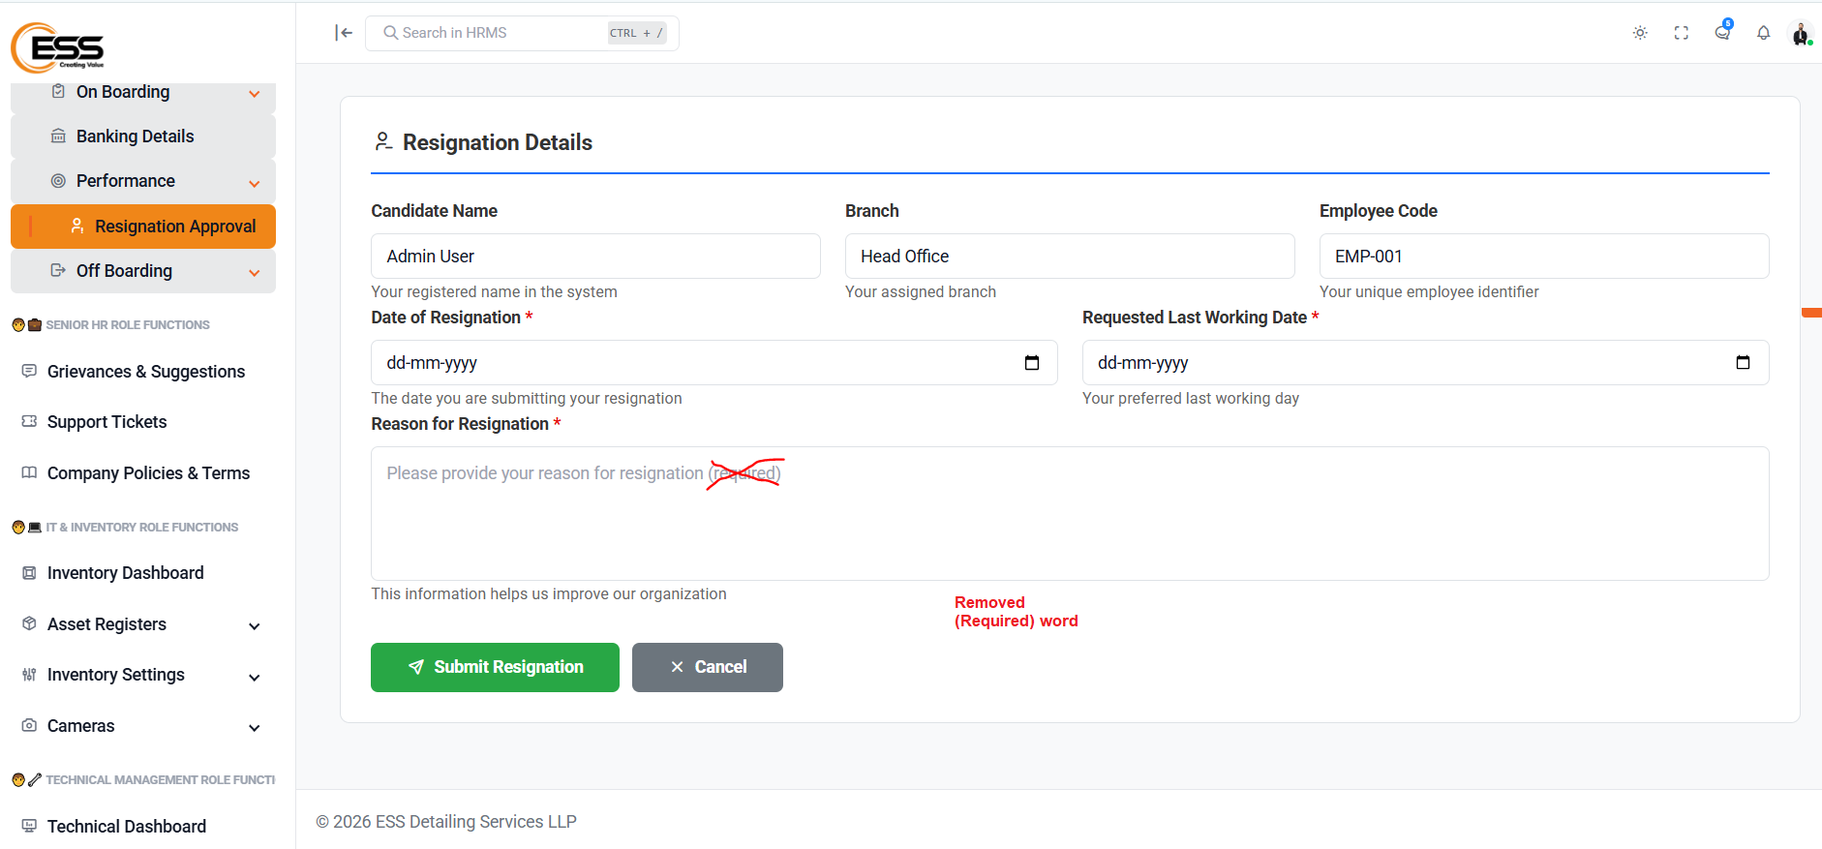
13) Fix Comments .

Slide 14
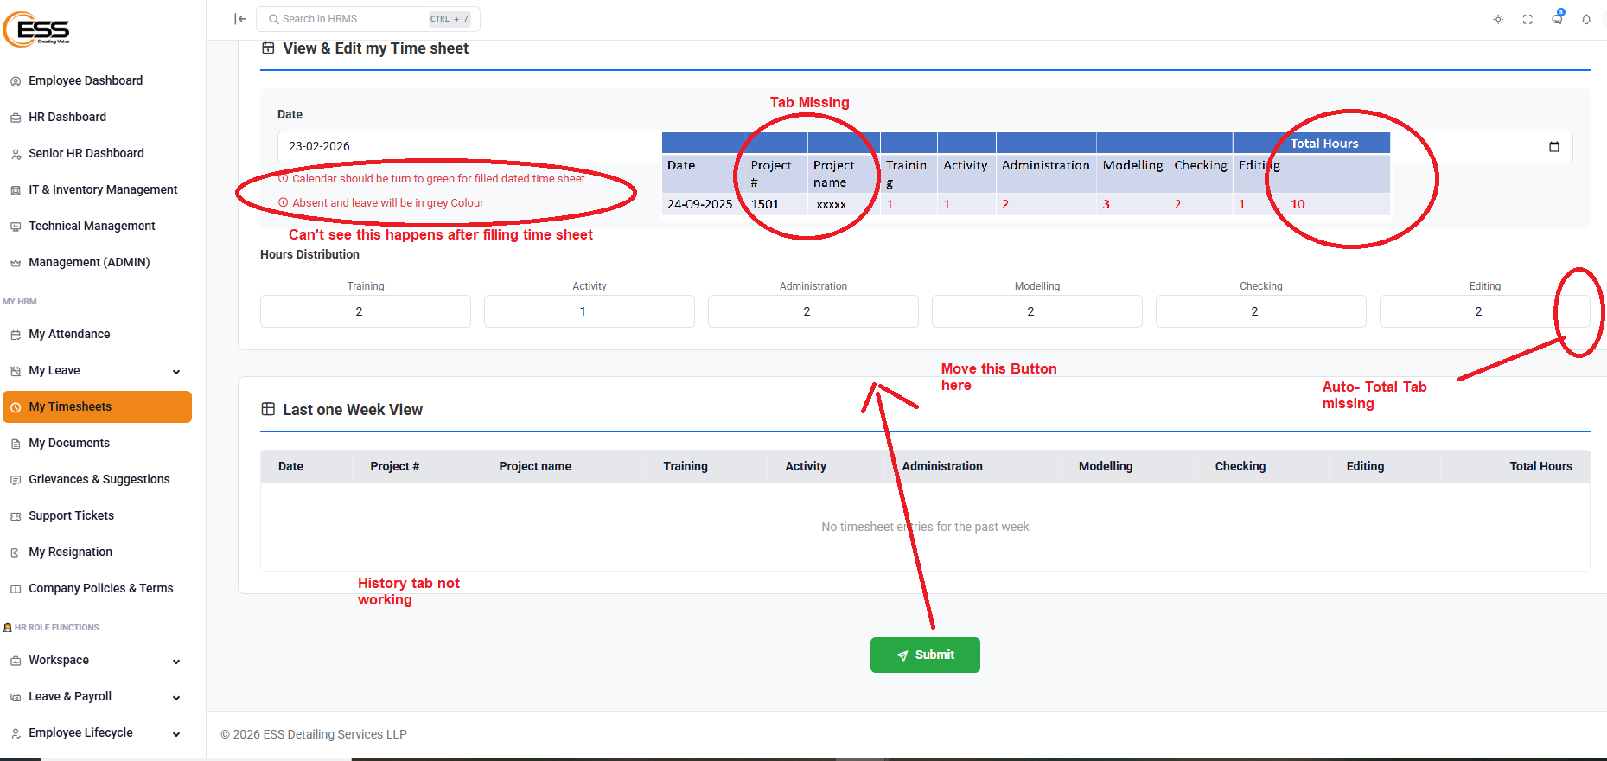
14) Fix Comments .

Slide 15
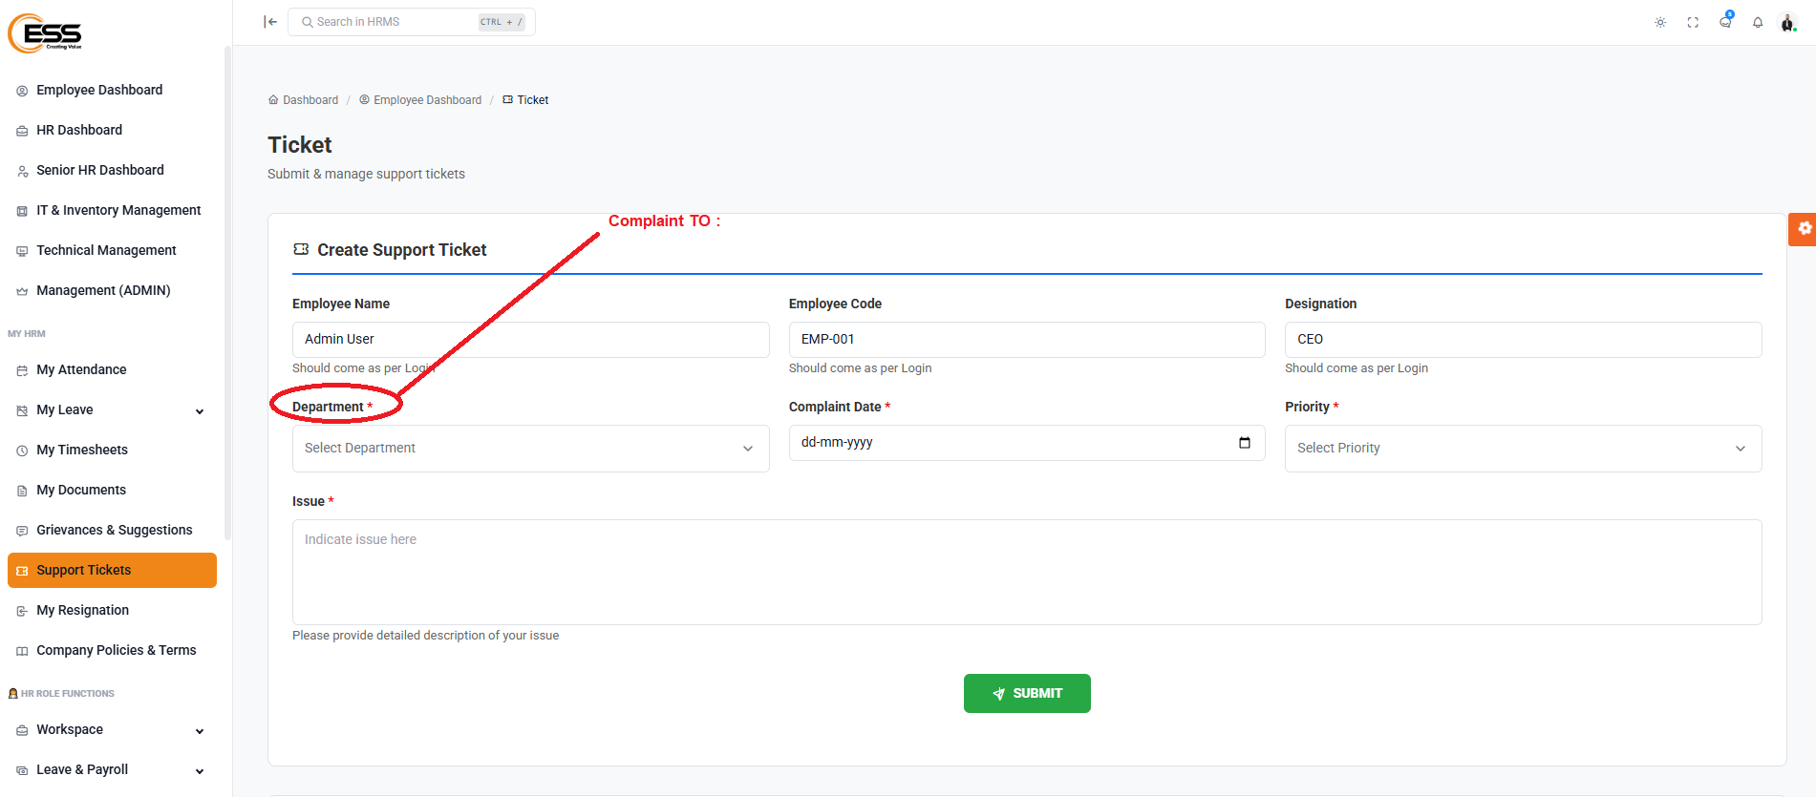
15) Fix Comments .

Slide 16
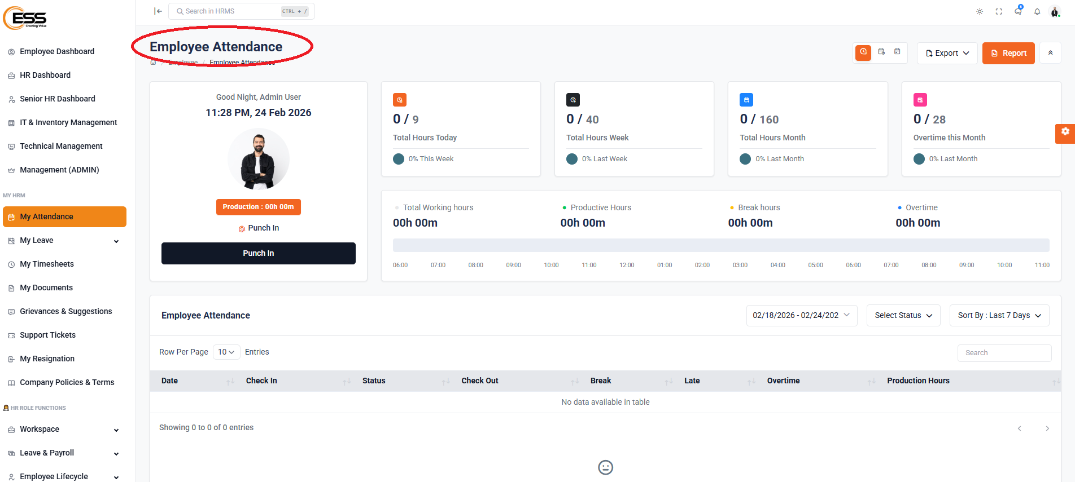
16) Similar to below…Employee Personal Dashboard required.it’s missing now

Slide 17
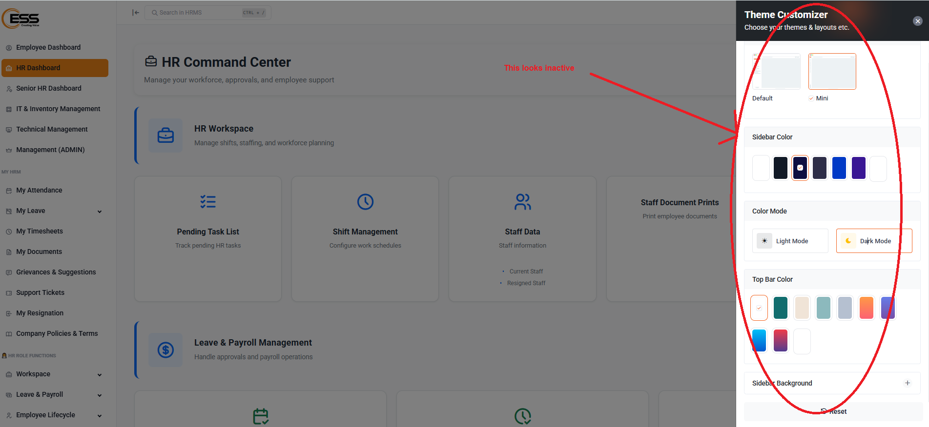
16) Fix

